Slide 1



Employee Management System
Presented By
Group No : 103
Shinde Darshana Kishor Roll No. 219176
Simi Mariya Vincent Roll No. 219196

Slide 2
Content
Introduction
Objectives
UML Diagrams
Screen Shots
Specification
Software & Hardware Requirements
Advantages
Conclusion
Future Enhancement
References

Slide 3
Introduction
Employee Management System is an essential software designed to keep track of employee information in any organization. It securely stores the employees’ personal as well as work-related details. This Project simplifies the task of maintain records because of its user friendly nature. The application is simplified as much as possible to avoid errors while entering the data. It also provides error messages while entering invalid data. No prior knowledge is required to use this system.
Moreover this application is designed for the particular need of the company to carry operations in a smooth manner. Only admin has the access to add new employee’s data. Admin can see and update each and every employee record.
Database will store all the details of employees such as name, designation, address, salary, mobile number etc. This application enables employees to apply for leave and check performance of employees.

Slide 4
Objectives
The main purpose of this system, is to reduce the consumption of time during maintaining the records of employees working in industry. Our System helps admin of industry to maintain records of employees and their performance. It also helps to keep record of leave management.
In other words, our Employee Management System has, following objectives:
Simple database is maintained.
Easy operations for the operator of the system. User interfaces are user accommodating and attractive; it takes very less time for the operator to use the system.
Technology Used:
Front end: React Js
Back end: Spring Boot
Database: My Sql
is to design a college website which implant update information of the college that should improve expertness of college record management.

Slide 5
Proposed System:-
The Employee Management System provides the feature for Admin and Employee:-
Record Management:
It will provide facility to admin keep records of every employee.
Performance Management:
It will provide facility to admin to update performance as employee of the month and employee can check employee of the month.
Leave Management:
It will provide facility to admin to approve leave of employee and employee can apply for leave.
s to design a college website which implant update information of the college that should improve expertness of college record management.

Slide 6
UML Diagrams

Slide 7
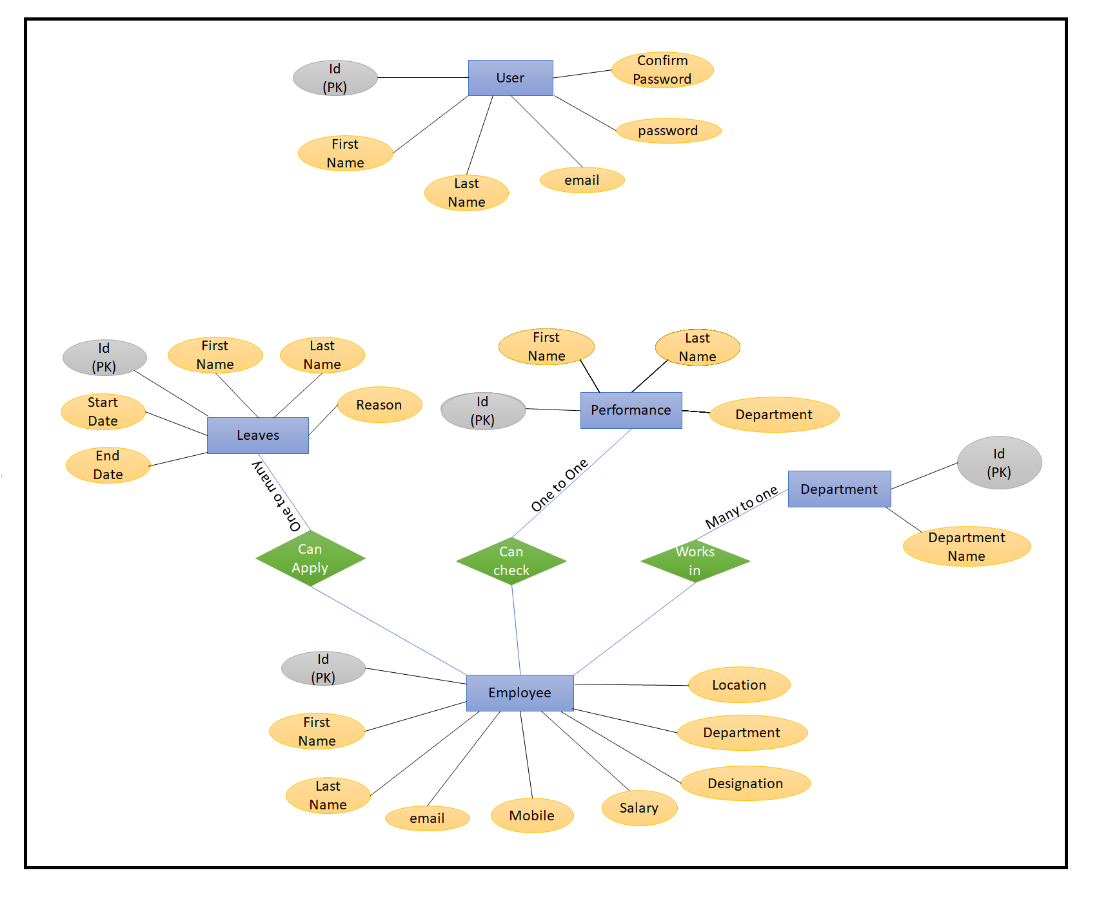
ER Diagram

Slide 8
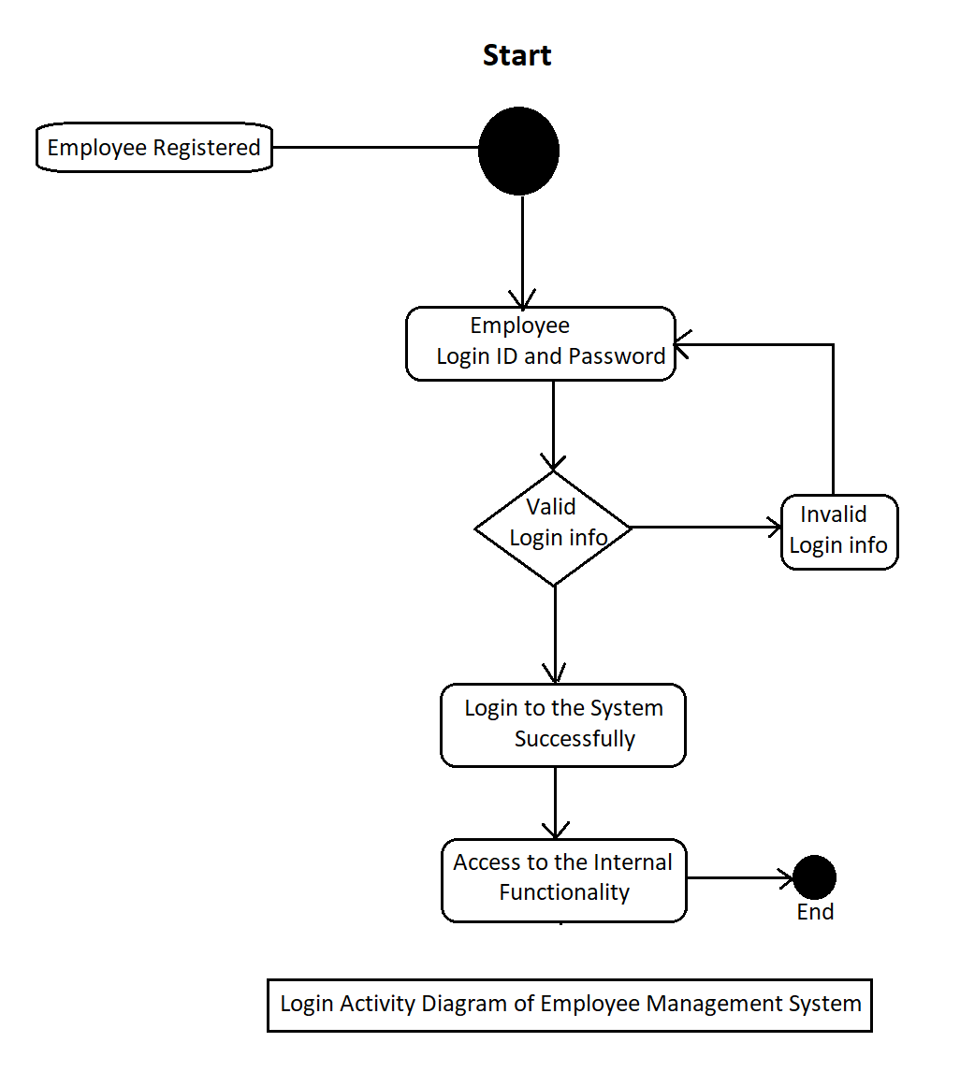
Login Activity

Slide 9
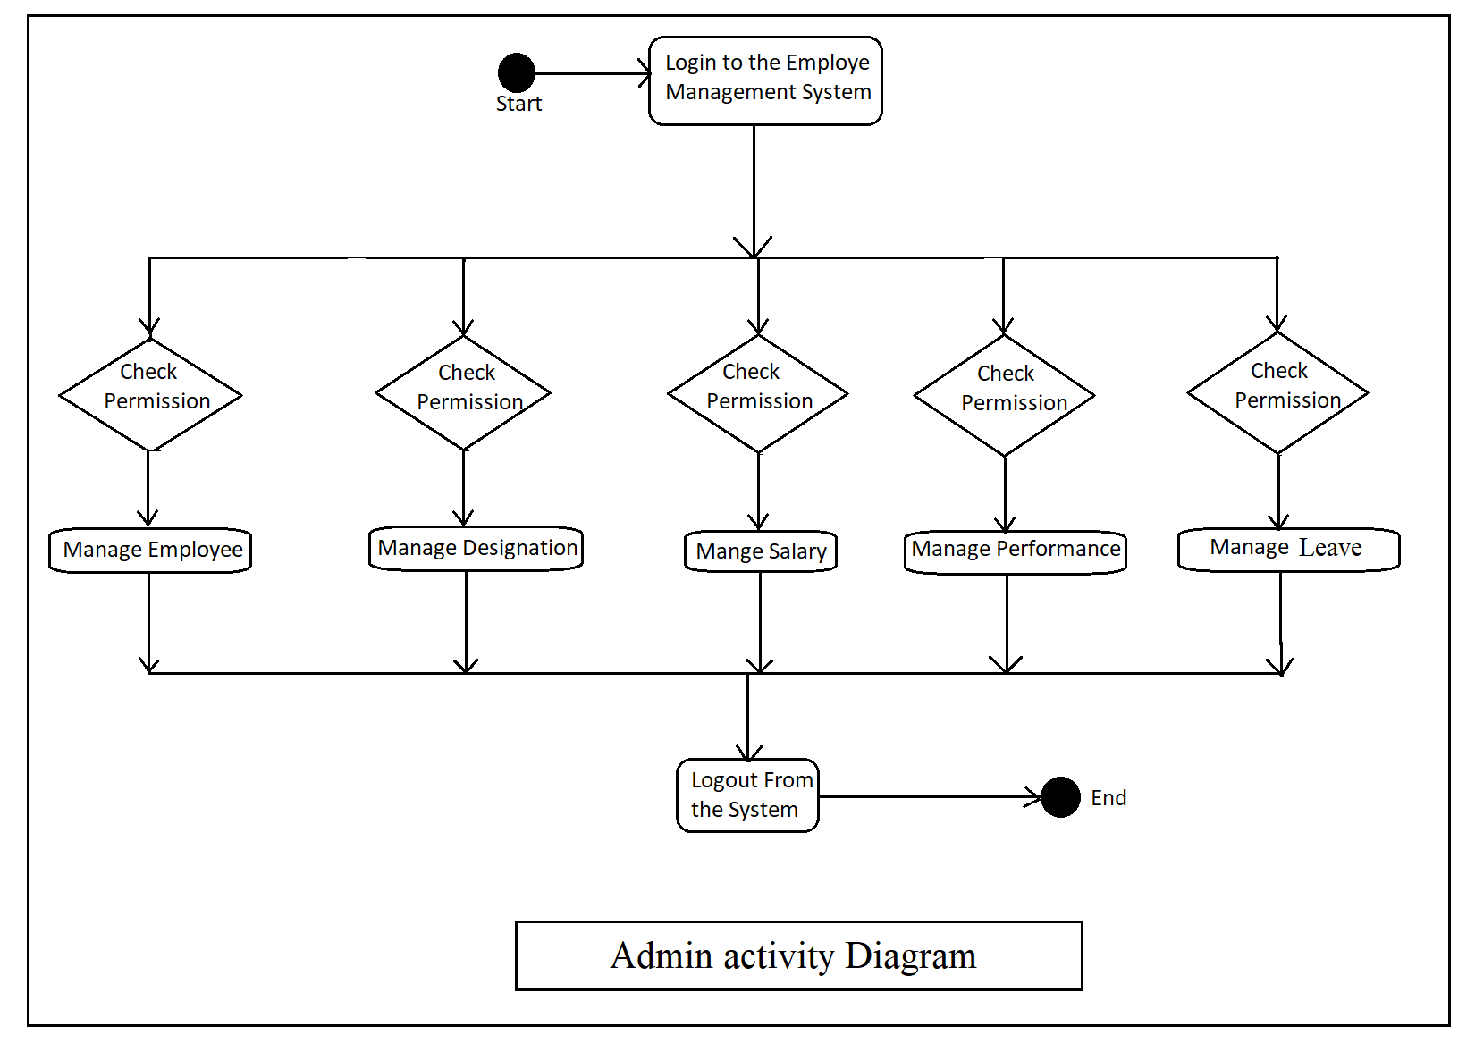
Admin Activity Diagram

Slide 10
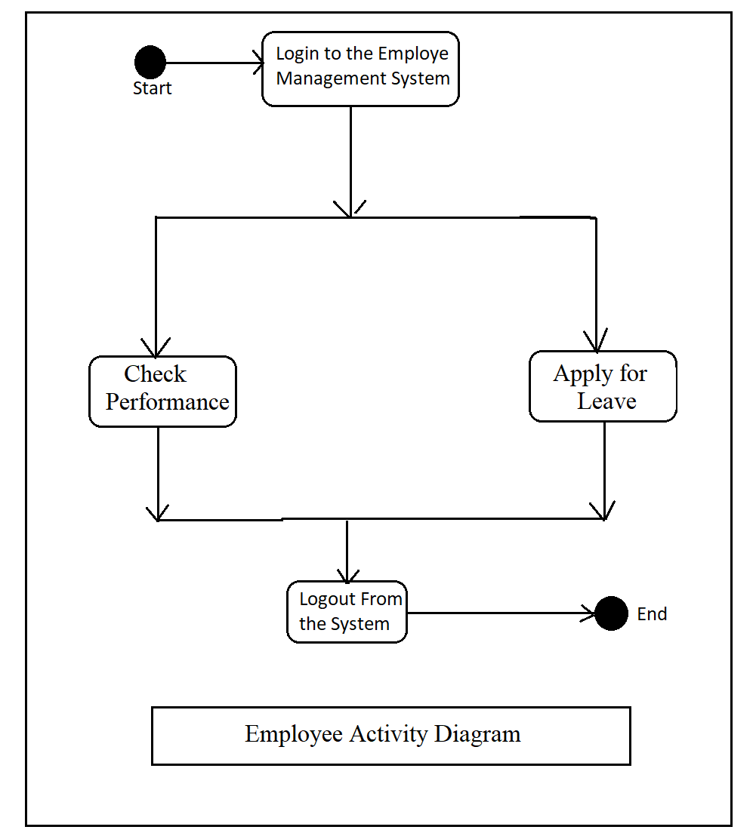
Employee Activity Diagram

Slide 11
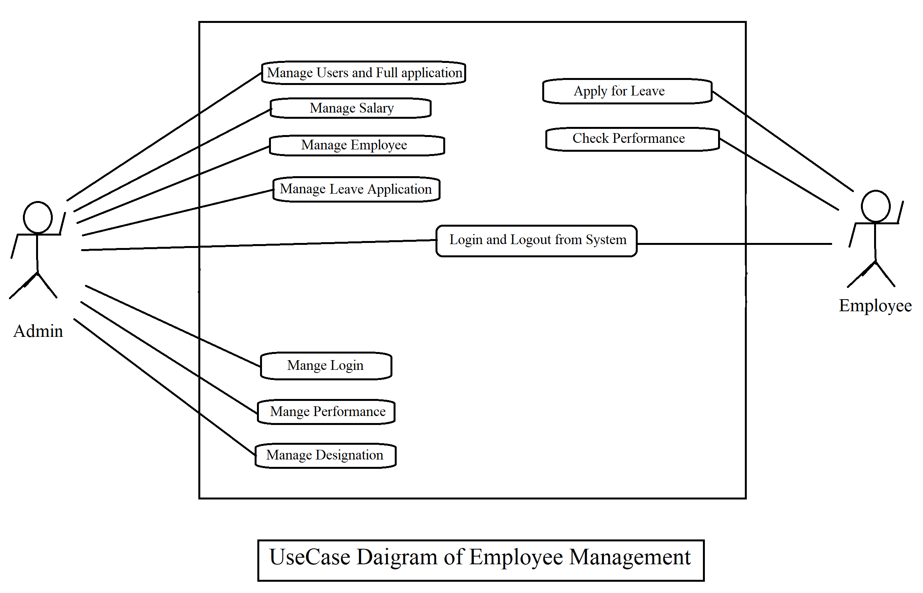
Use Case Diagram

Slide 12
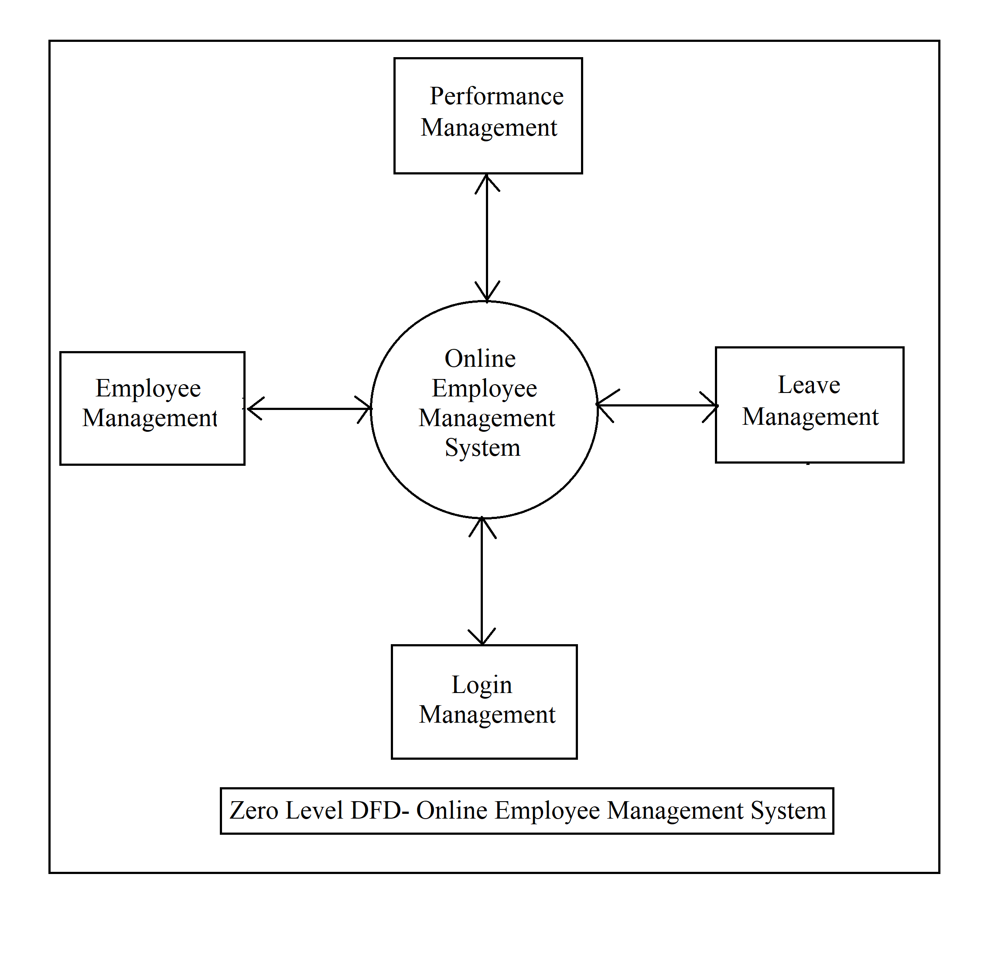
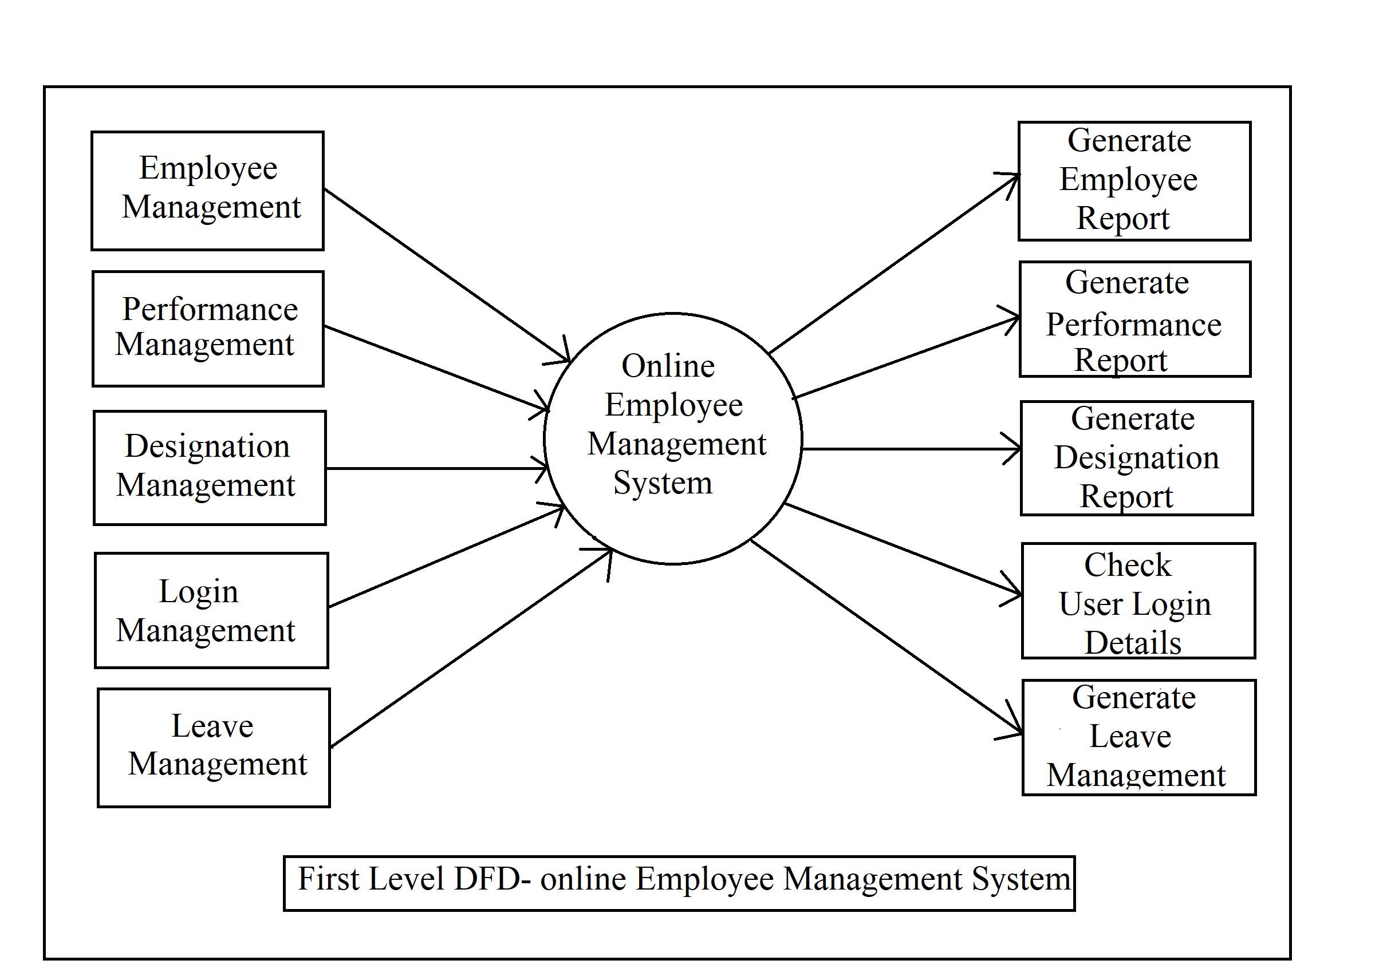
DFD Diagram

Slide 13
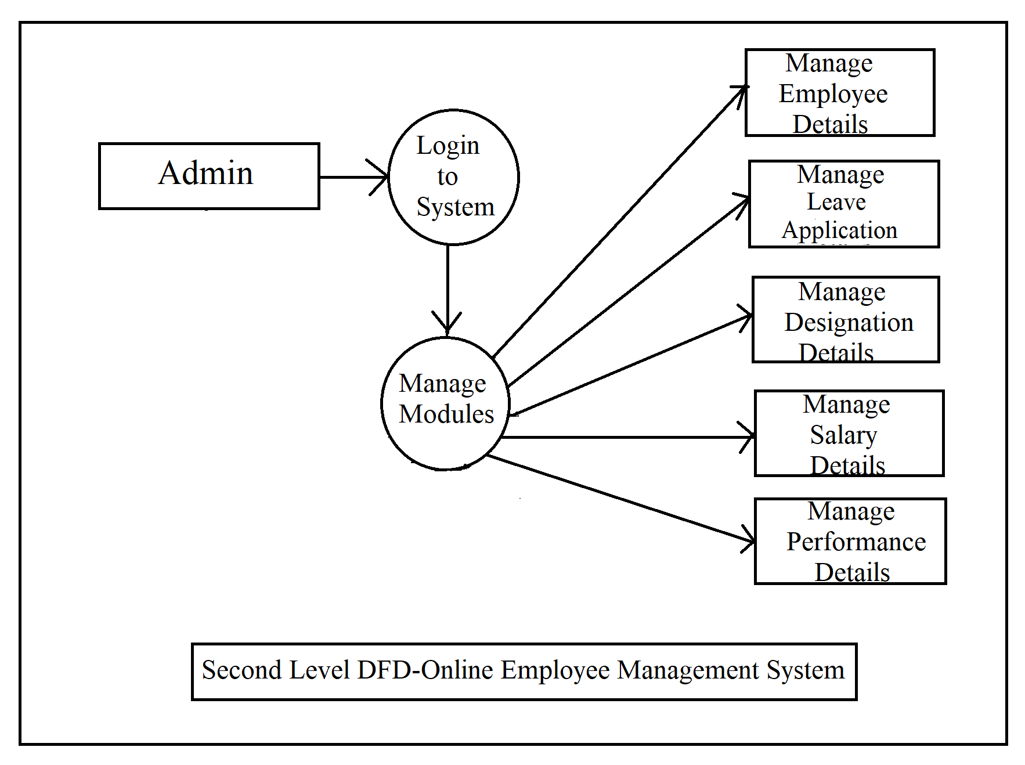
DFD Diagram

Slide 14
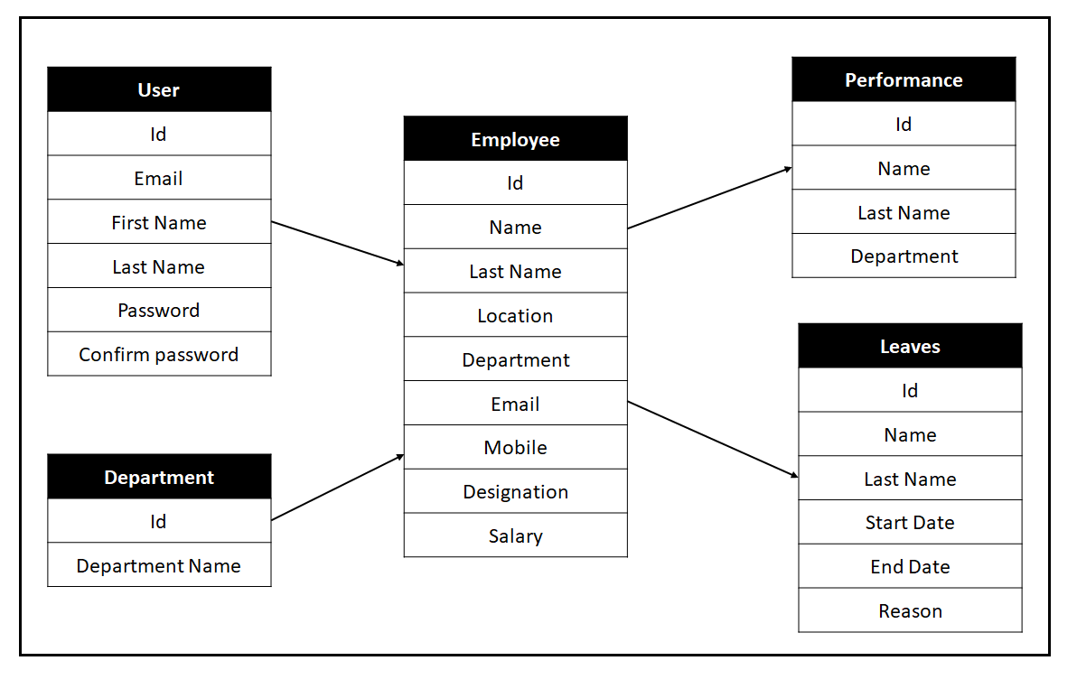
Class Diagram

Slide 15
Screen Shots

Slide 16
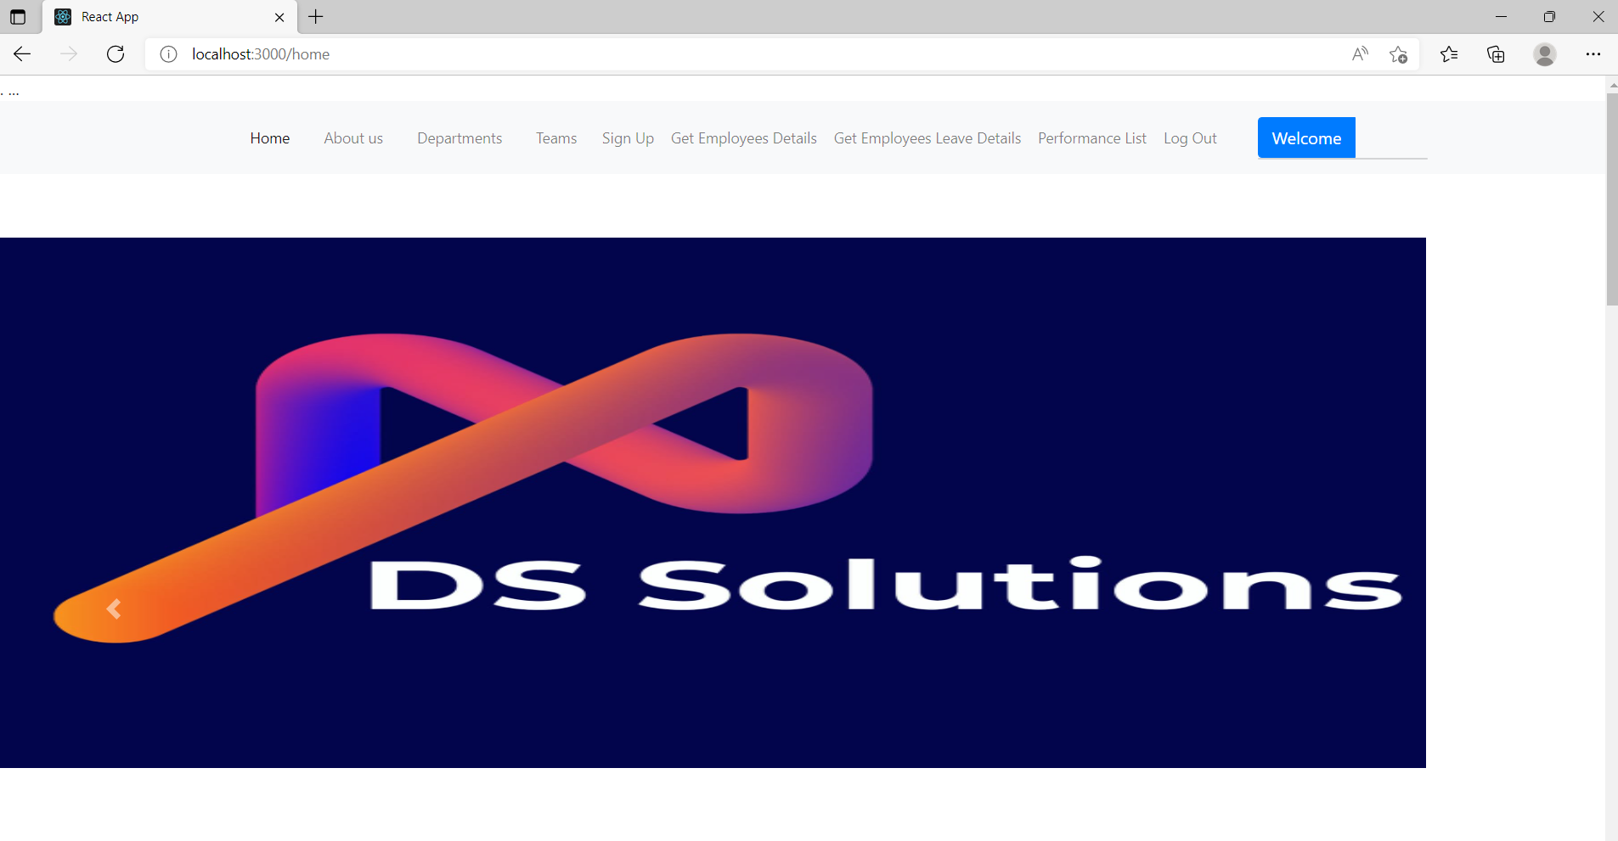
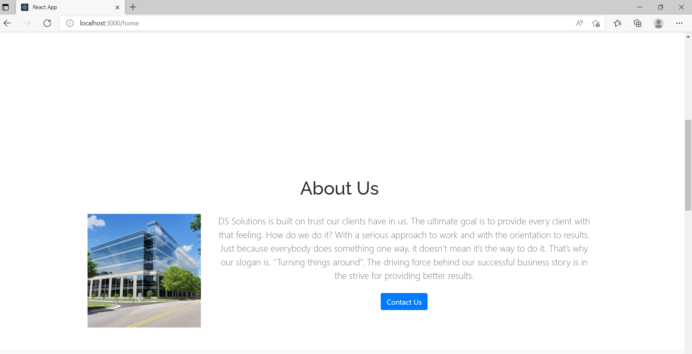

Slide 17
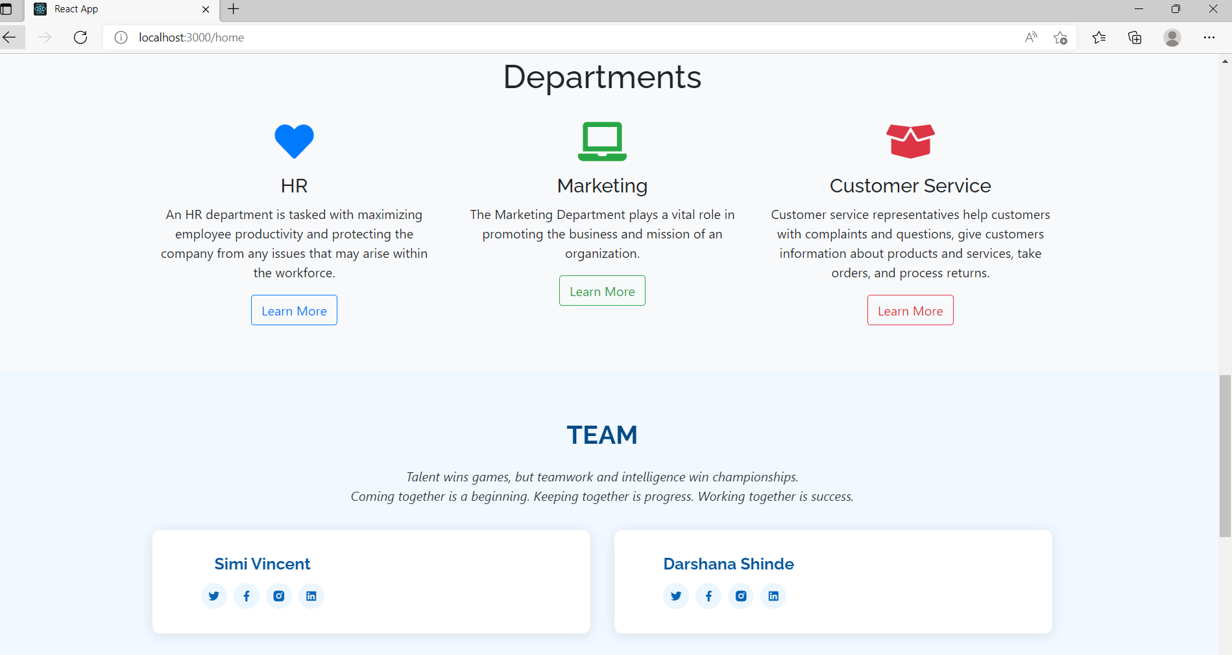
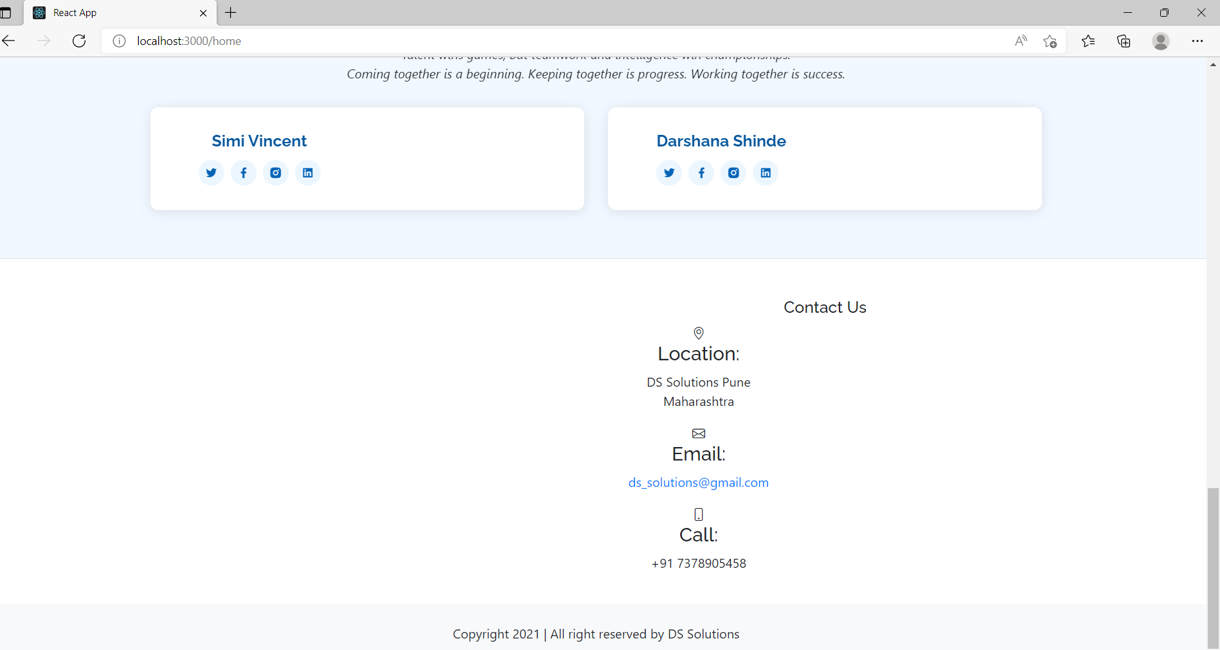

Slide 18
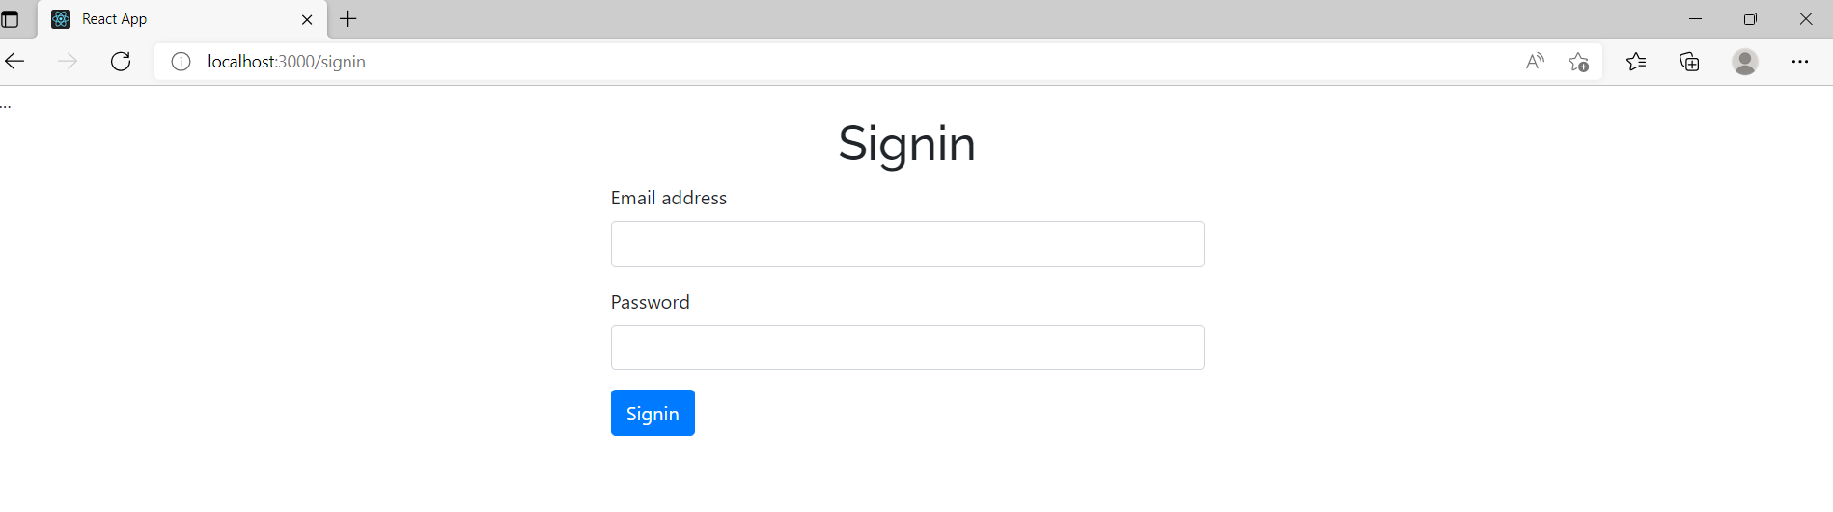
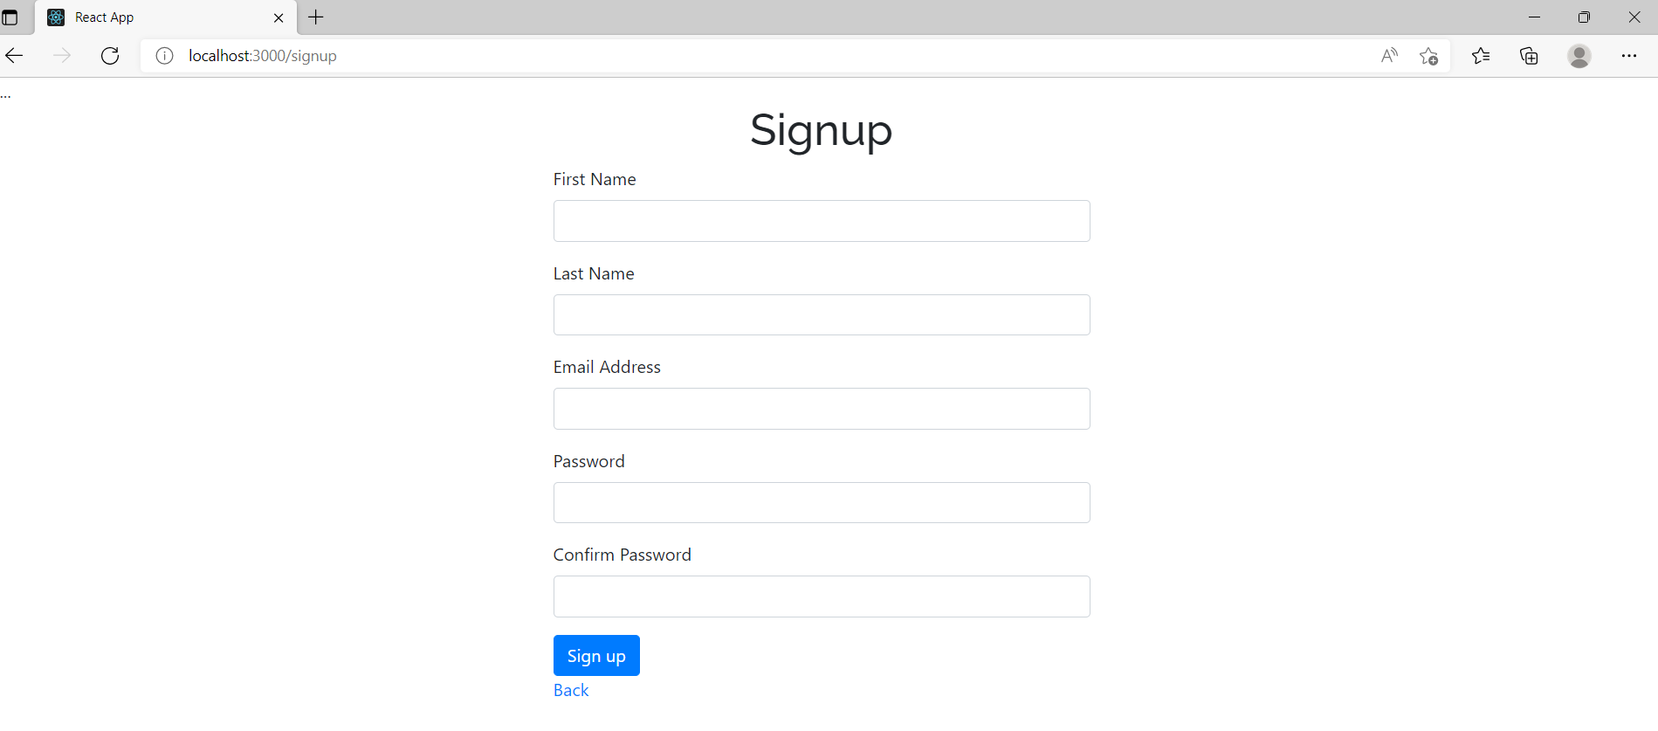

Slide 19
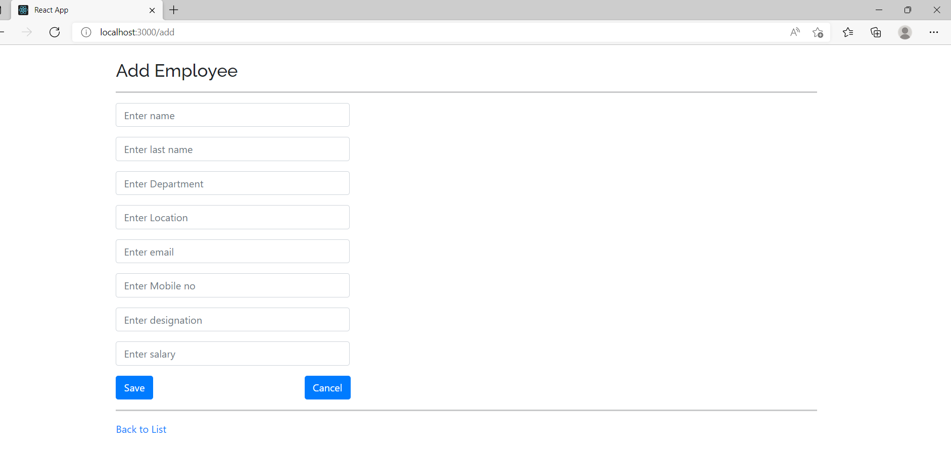
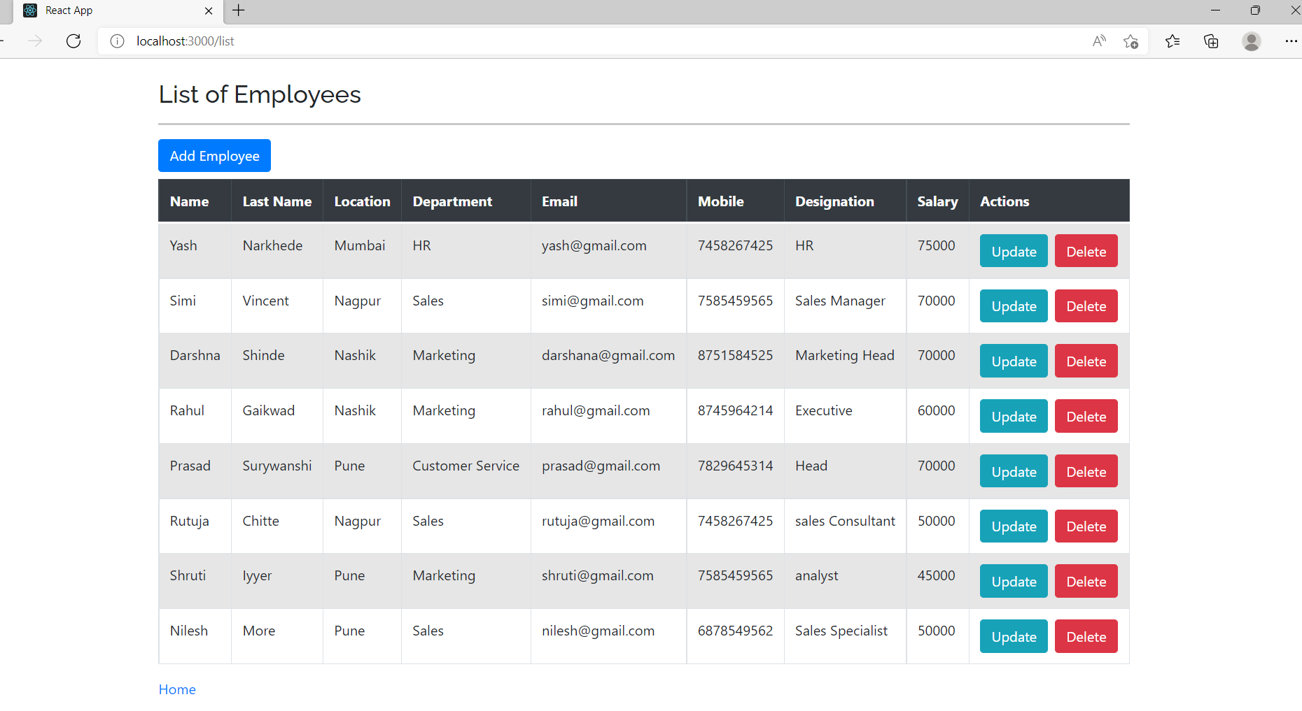

Slide 20
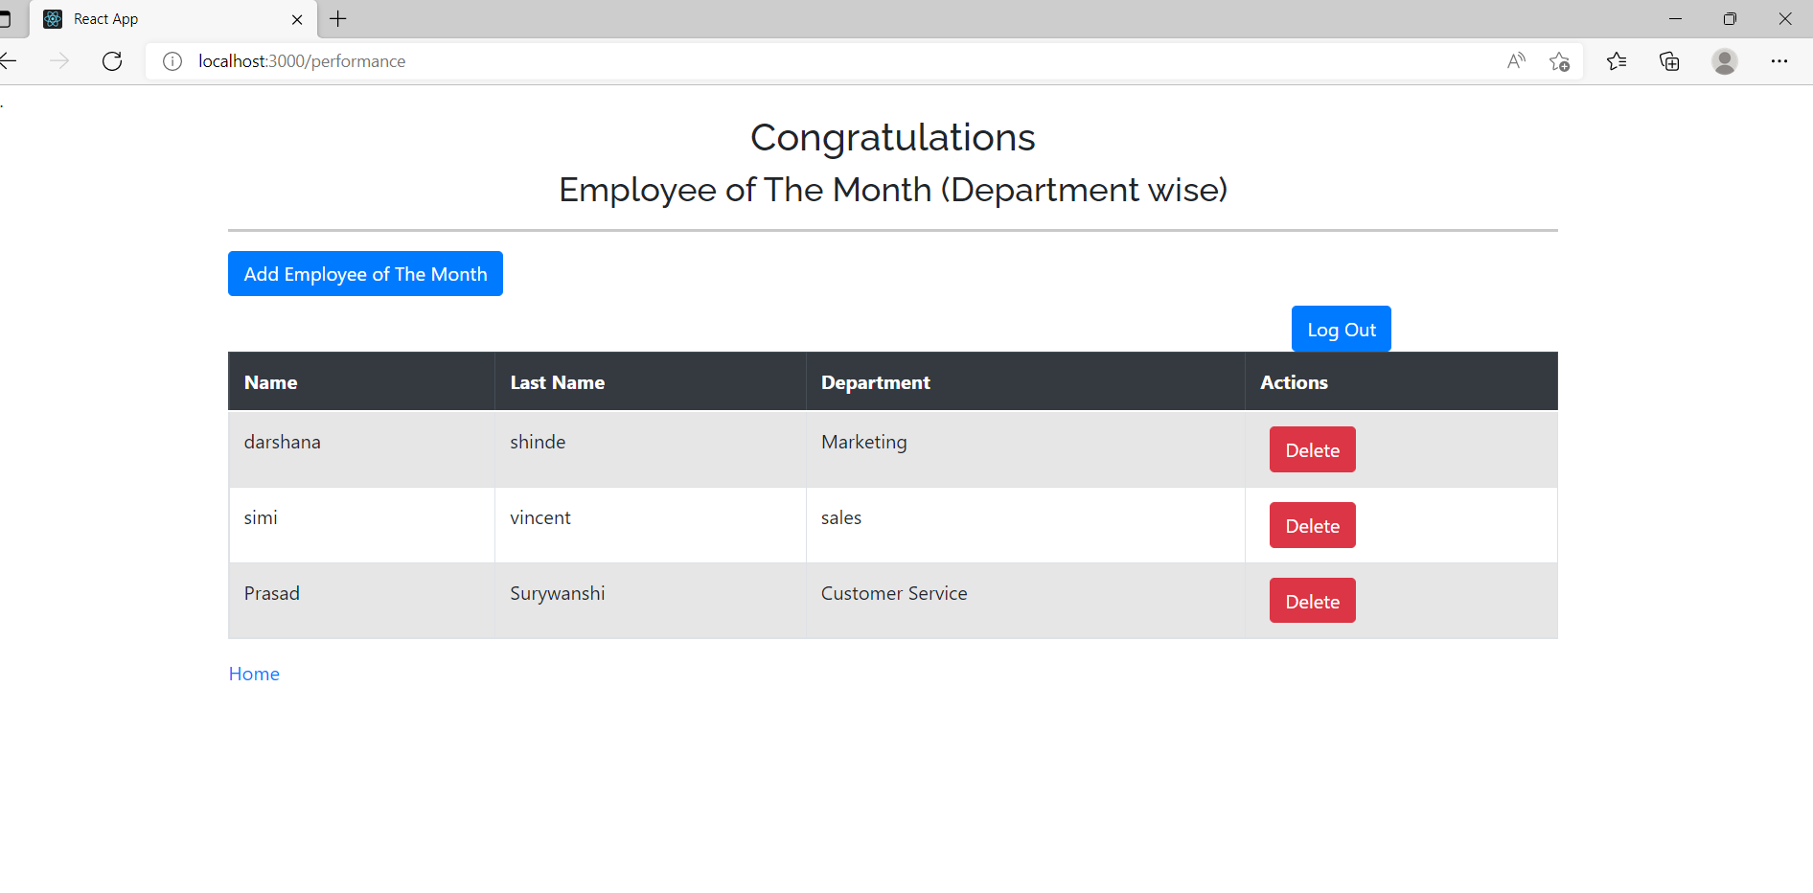
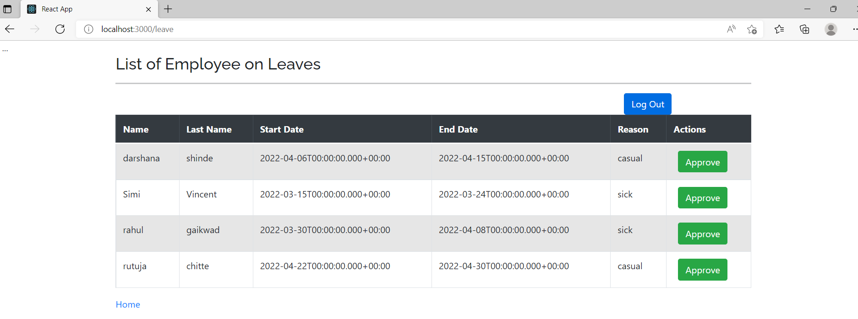

Slide 21
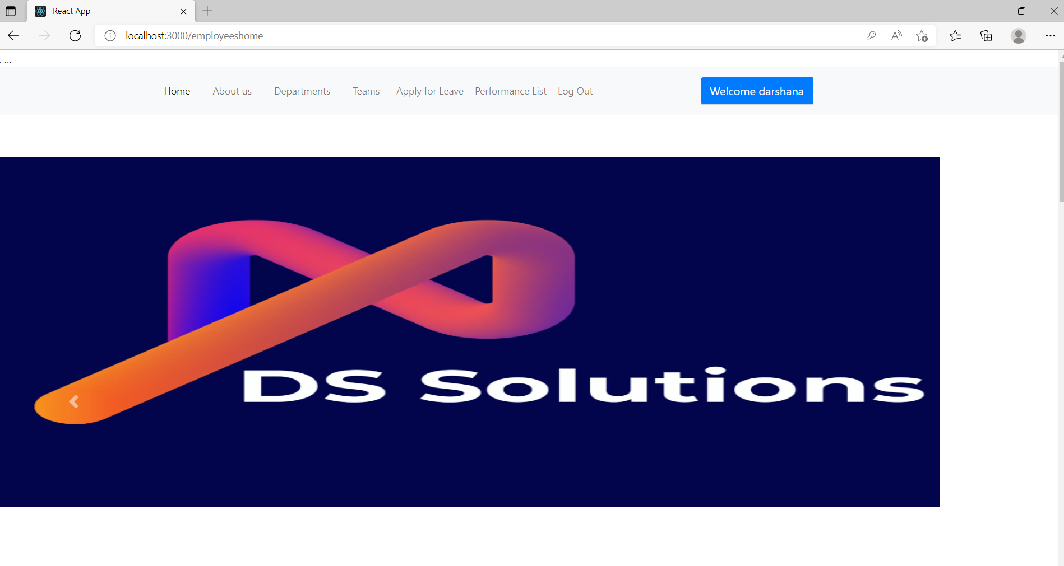

Slide 22
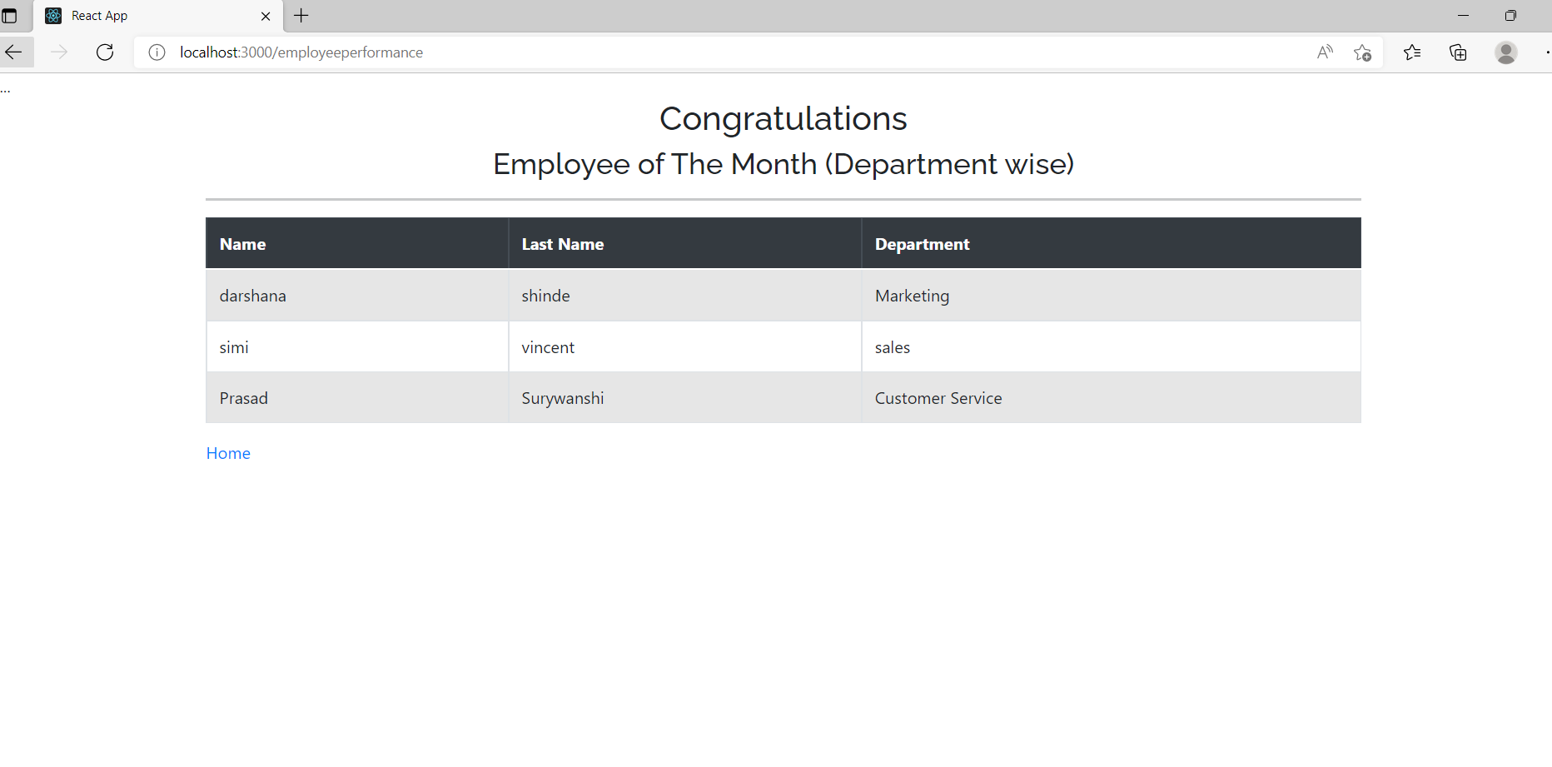
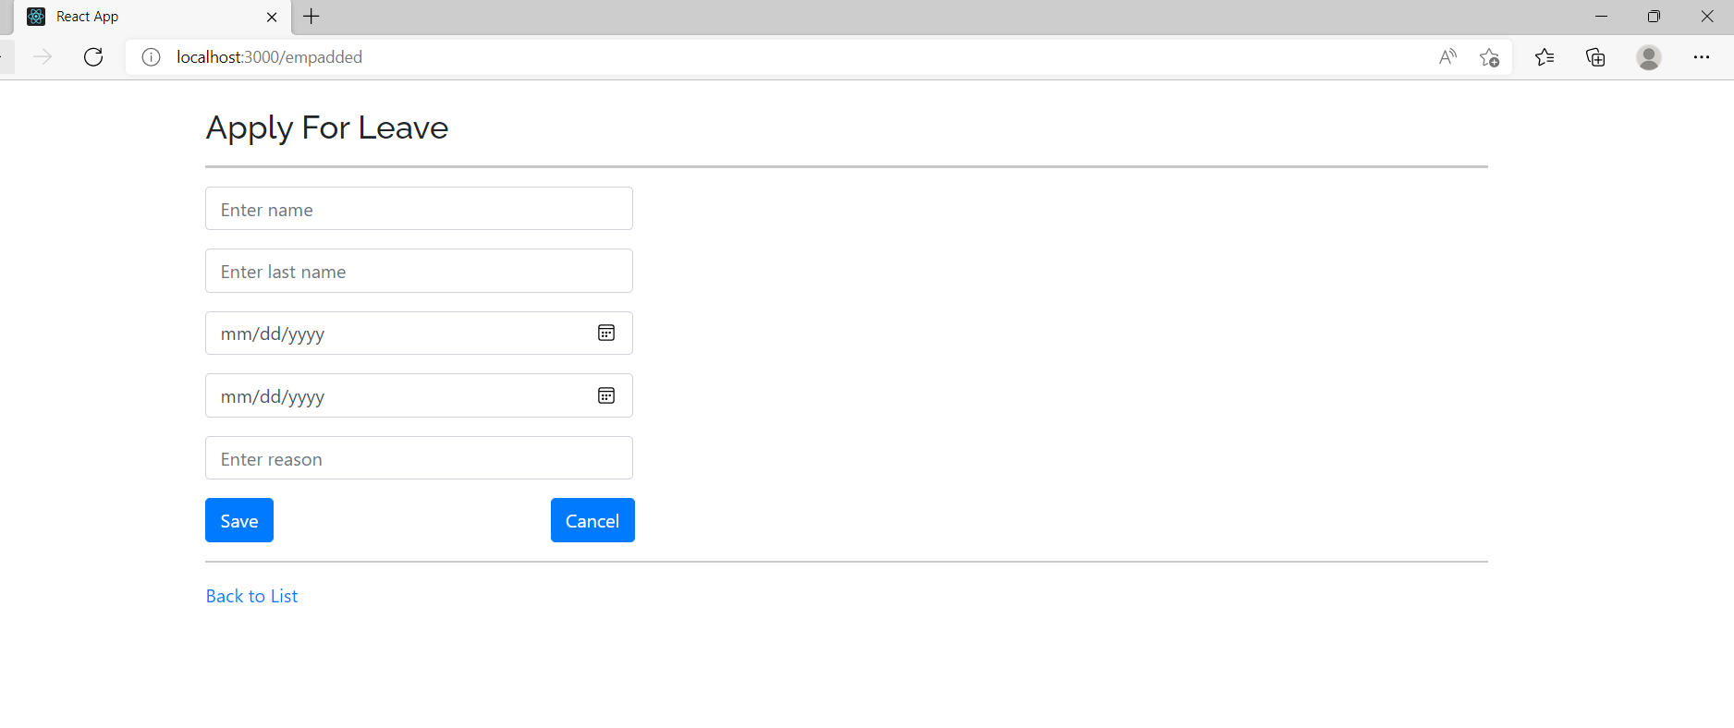

Slide 23
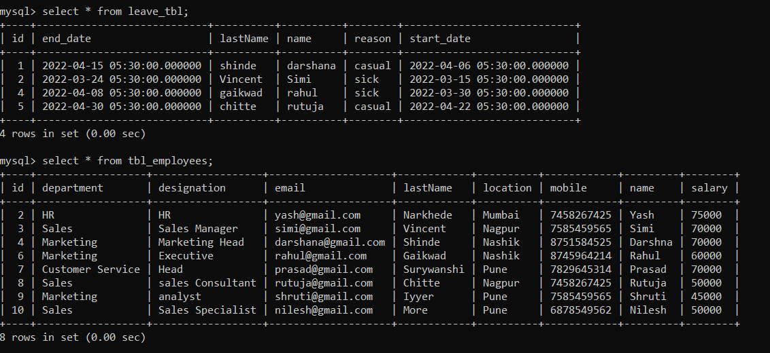
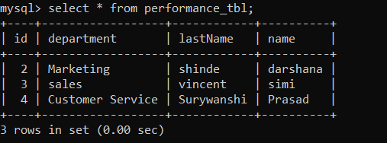
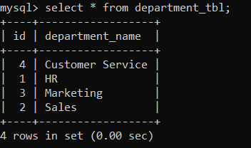
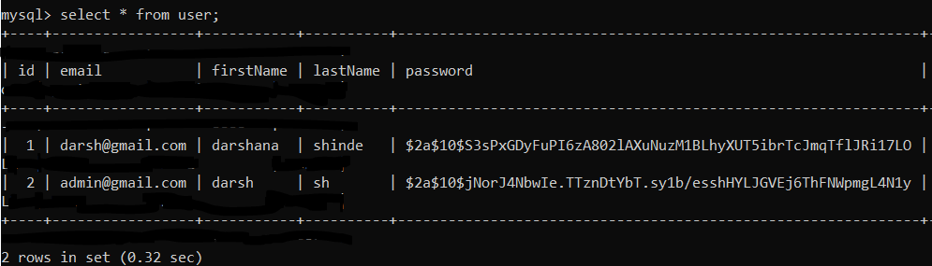

Slide 24
Specification
The application will use JavaScript, jQuery and CSS as main web technologies.
HTTP protocol is used as communication protocols.
Since Employee Management System is a web-based application, internet connection must be established.
The Employee Management System will be used on PCs and will function via internet or intranet in any web browser.

Slide 25
Software & Hardware Requirements
Server Side
Client Side (Minimum requirement)
Web Server | TOMCAT
Server side language | REACT
Database | MYSQL
Web Browser | Google Chrome or any compatible browser
Operating System | Windows or any equivalent OS
Web Browser | Google Chrome or any compatible browser
Operating System | Windows or any equivalent OS
RAM | Minimum 1GB
Processor | Intel Dual Core

Slide 26
Advantages
Managing Employee Information
Effortless Communication
It is easy to use
Lesser time requirement to maintain and manage records of Employee
All requirements at one platform
Managing Performance and Leaves record of employee

Slide 27
Conclusion
This project aid in automating the existing manual system. This is a paperless work. It can be monitored and guarded remotely. It cut down the man power required and provides accurate information. All years together huddled information can be saved and can be accessed at any time. For this reason, the data stored in the repository helps in taking decision by management. So, it is improved to have a Web Based system.
Employee Management System is an application to securely store and manage the personal as well as other work-related details of the employees. The EMS helps to eliminate the manual process of managing the data hence saving a lot of time and money.

Slide 28
Future Enhancement
The Employee Management System can be used in any organizations like an IT industry or hospitals. There is always a scope of future enhancements.
1. Module to mark the attendance of employee.
2. Module to calculate the salary of the employee.
The software is flexible enough to be modified and implemented as per future requirements. We have tried our Best to present this free and user–friendly website to Industries.

Slide 29
References
https://spring.io/projects/spring-boot
https://www.w3schools.com/REACT/DEFAULT.ASP
https://www.w3schools.com/js/default.asp
https://www.w3schools.com/sql/default.asp

Slide 30
Thank You

